Slide 1
PHISHING EMAIL DETECTION CYBERSECURITY SRICHERAN CH AI&DS–A 22011101023

Slide 2
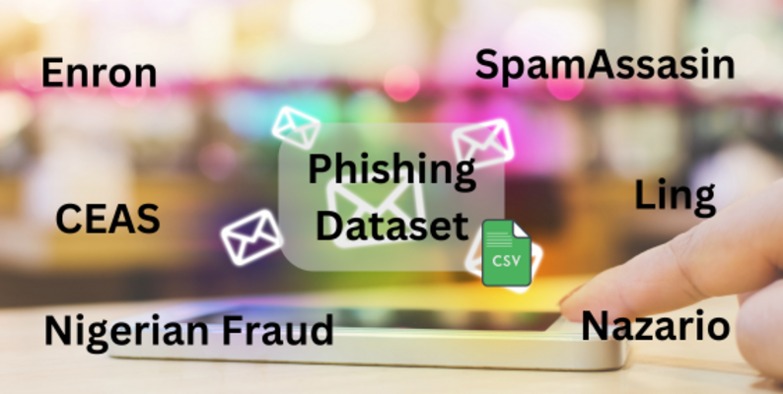
DATASET DESCRIPTION
Initial Datasets:
Enron and Ling Datasets: These datasets focus on the core content of phishing emails, containing subject lines, email body text, and labels indicating whether the email is spam (phishing) or legitimate.
CEAS, Nazario, Nigerian Fraud, and SpamAssassin Datasets: These datasets provide broader context for the emails, including sender information, recipient information, date, and labels for spam/legitimate classification.
Final Dataset:
The final dataset combines the information from the initial datasets into a single resource for analysis. This dataset contains:
Approximately 82,500 emails
42,891 spam emails
39,595 legitimate emails

Slide 3
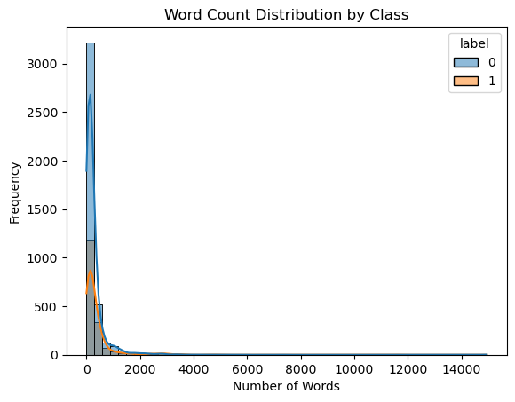
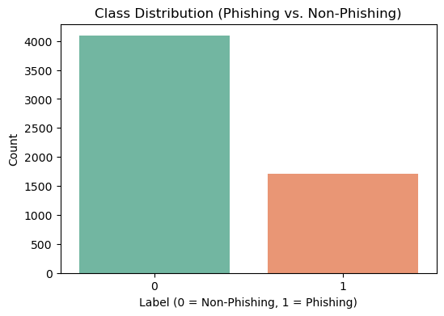
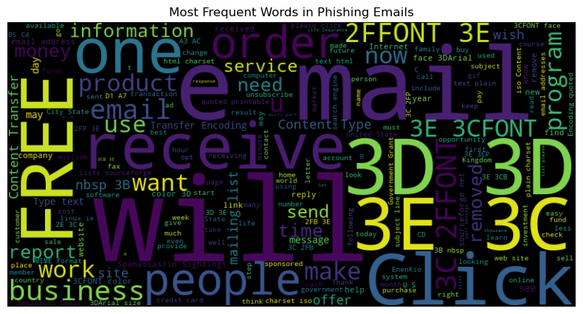
Initial methods
Only SpamAssian dataset : Data preprocessing (remove nan values) and Analysis Total:5809 rows

Slide 4
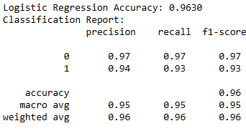
Initial methods
Combine all sender, body, subject as single string, and get embeddings using Sbert and classified using Logistic Reg:

Slide 5
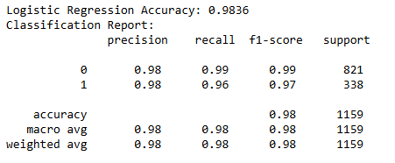
Initial methods
Change of approach
Extract URLS from the body column using Regex and Instead of single string, Get separate embeddings of individual column and Word2Vec for extracted_url and concatenate all as combined_embedding and classifies using Logistic Reg:

Slide 6
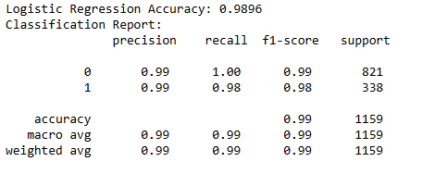
Initial methods
Change of approach
Extract URLS from the body column using Regex and Instead of single string, Get separate embeddings of individual column including extracted_url and concatenate all as combined_embedding and classifies using Logistic Reg:

Slide 7

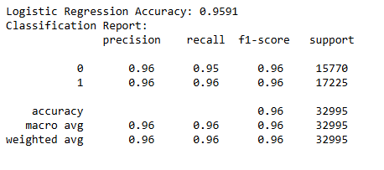
Model evaluation on combined dataset [82486 rows]
Merged Dataset was test on Logistic Reg model fit on 5809 rows SpamAssian dataset:
For improvement, Merged Dataset was fit to classify using Logistic Reg:

Slide 8
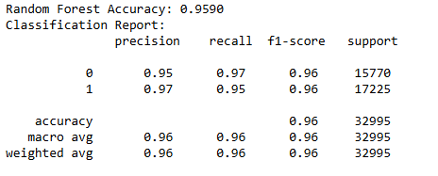
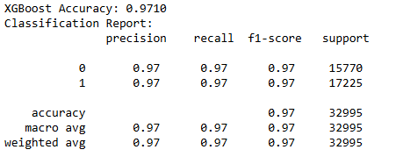
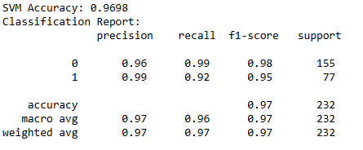
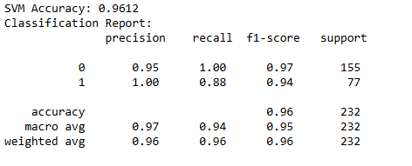
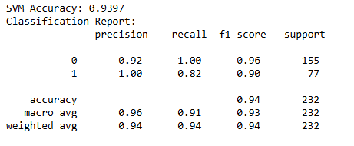
Comparison of various models on merGed dataset
RANDOM FOREST: XGBOOST:
SVM [linear] : SVM [rbf]: SVM [poly]:

Slide 9
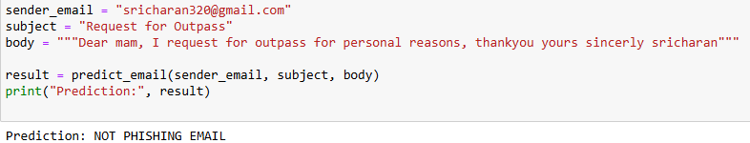
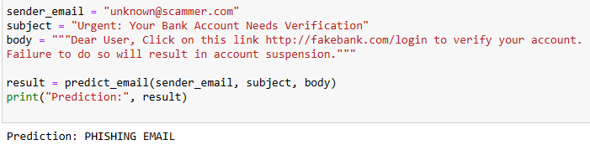
SVM MODEL on real world

Slide 10


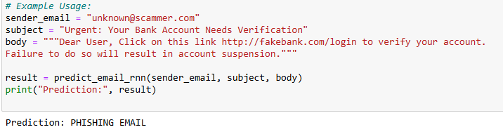
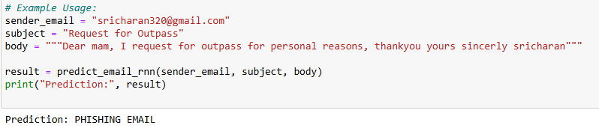
Improvements: Rnn and lstm trained on 24 epochs
RNN: LSTM:
RNN ON REAL WORLD EMAIL: => Doesn’t work great

Slide 11
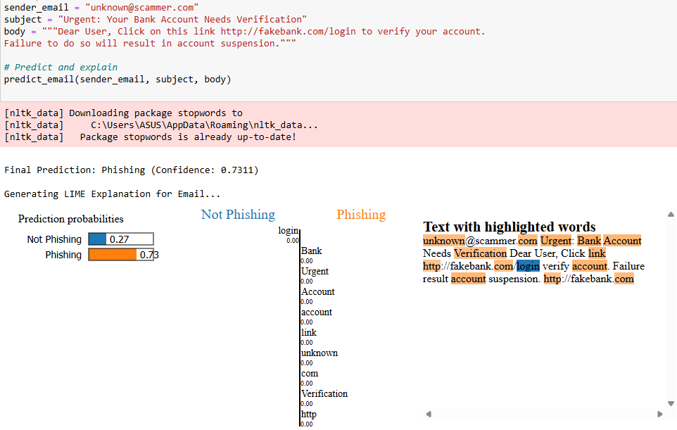
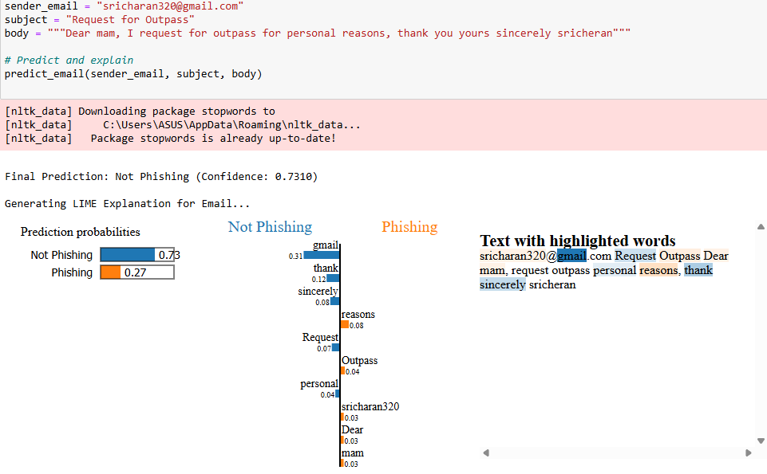
Improvements ON LSTM:
Removal of Stop Words on input
Explainable AI (XAI) LIME

Slide 12

Thank you

